Slide 1


Are We Making It Hard to Be Honest?
Six Ways the Current Life and Disability Insurance Questions Might be Discouraging Truthfulness and What You Can do About it
William Trump, Founder and Lead Consultant at Unconventional Wisdom

Slide 2







Who We Are
We’re a behavioural science consultancy specialising in insurance.
Combining the latest psychological insights with over 13 years of applied experience, we help you achieve better business results by understanding how your customers and employees think and behave.
A selection of our clients
Notes:
We love the way you guys augment our team” Nick Howard, CTO at Assurance

Slide 3



Who We Are
William Trump
Charlotte Craig
Yash Panjwani
Founder and Lead Consultant​
​
Pioneered Behavioural Science within insurance; 14 years at Swiss Re. ​
12+ years’ experience running and growing behavioural teams
Behavioural Science Consultant​
​
MSc. in Behavioural Economics ​
Specialist in behavioural science and customer insight research within financial services​
Behavioural AI Consultant​
​
MSc in Behavioural & Data Science​
Specialist in AI adoption and behavioural design of AI tools to increase business impact​

Slide 4
Are We Making It Hard to Be Honest?
Six Ways the Current Life and Disability Insurance Questions Might be Discouraging Truthfulness and What You Can do About it

Slide 5

1
We Ask for Honesty Too Late
We ask customers to declare they were truthful towards the end of the filling the form, at which point it’s too late

Slide 6

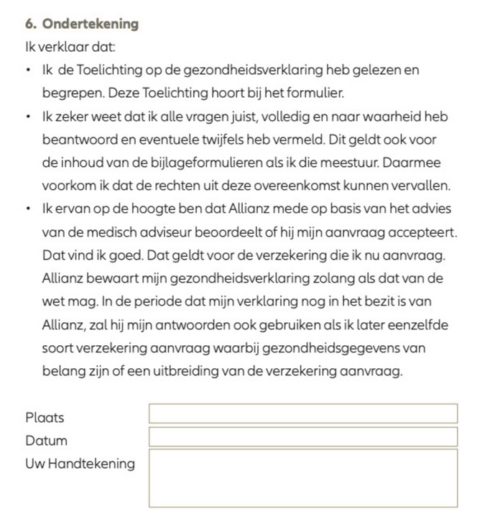
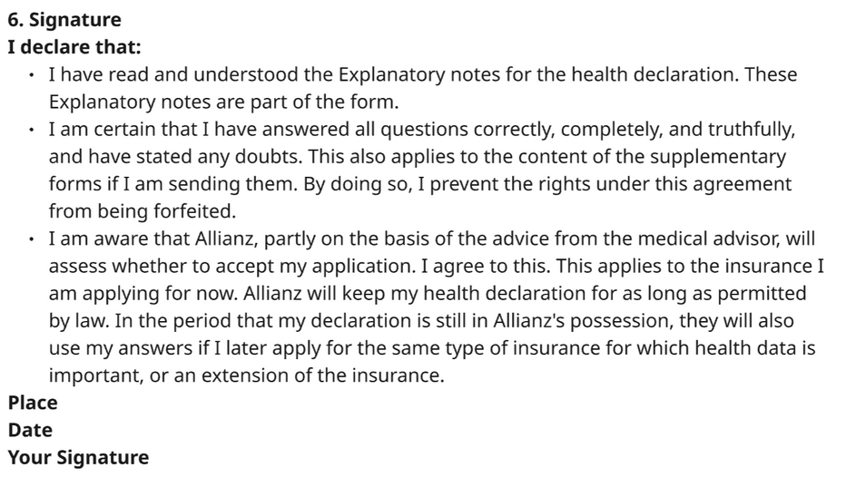
WHAT GOES WRONG
Yes
We place the legal declaration ("I confirm that I have answered all questions completely and truthfully...") after customers have filled in all the health questions.
By this point, any "bending of the truth" has already happened. The declaration serves as a legal checkbox rather than a guide for behaviour.
HONESTY DECLARATION AT THE END
DUTCH
ENGLISH
Notes:
When we ask for sensitive health information without saying why it matters or how it will be used, the process can feel invasive. This erodes trust and increases the likelihood of customers giving incomplete or inaccurate answers.

Slide 7

BEHAVIOURAL SCIENCE INSIGHT
Commitment: People are far more likely to behave honestly if they have actively committed to being honest at the start of a questionnaire.
This also taps into people’s desire to be consistent with their past selves/ the idea of themselves when they made an active commitment (e.g. “I am an honest person”).

Slide 8

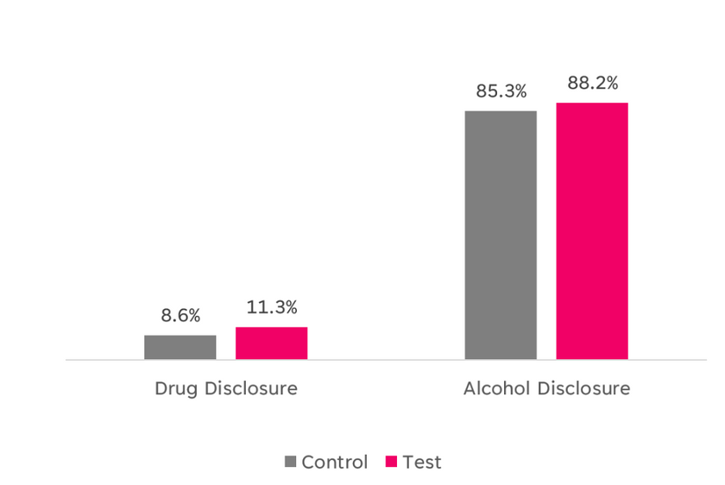
HOW TO FIX IT
AND IT WORKS...
Move the pledge to the start of the questionnaire. Before asking the first medical question, add a simple "honesty prime".
Proposed wording: "To help us provide you with the right cover, please confirm that you will answer the following questions as accurately and completely as you can."

Slide 9

2
We Signal the “Right” Answer
The way questions are framed often reveal which response is preferable, making customers less likely to answer truthfully.

Slide 10
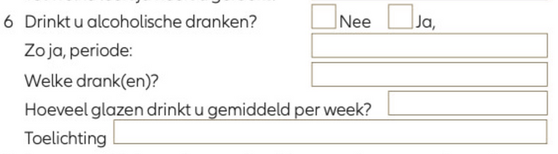
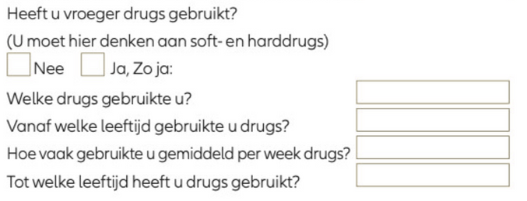
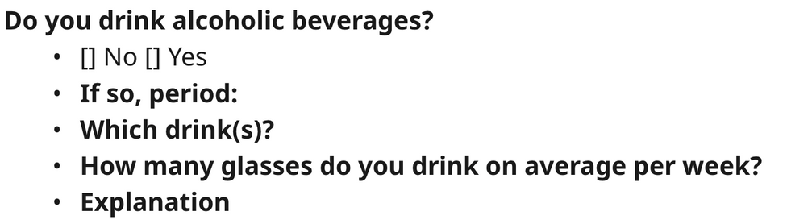
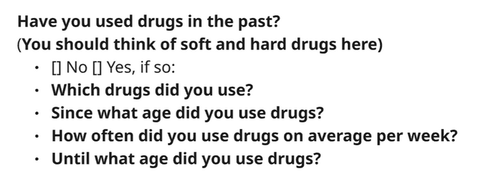
WHAT GOES WRONG
Binary Yes/No questions can unintentionally reveal which answer is preferable/acceptable
Often they create an obvious "right" answer (shorter path, lower price) and "wrong" answer (more questions, higher price), tempting users to choose the path of least resistance, even if it's not entirely accurate.
DUTCH
DUTCH
ENGLISH
ENGLISH

Slide 11
BEHAVIOURAL SCIENCE INSIGHT
When there is a clear "right" and "wrong" answer, people are motivated to say what they think we want to hear or what will help them achieve their goal (completing the journey, getting a quote).
Binary questions can trigger the social desirability bias — people tend to answer questions in a way that will be viewed favourably by others, which is exacerbated when one option clearly sounds worse.

Slide 12
HOW TO FIX IT
Framing: Use multiple-choice questions to avoid signalling the “right” answer.
Wording: Keep language neutral and non-judgemental.
Normalising: Use response ranges that place extreme behaviours in the middle to normalise honest answers (e.g. 0–1 / 2–4 / 5–10 / 10+).
Notes:
Ask about actual past behaviour (e.g. “How many times in the last month have you...?”)

Slide 13
HOW TO FIX IT
How often do you drink alcohol?
☐ Every day
☐ Most days
☐ A few times per week
☐ Once or twice per week
☐ Less than once per week - or never
AND IT WORKS...
Dutch insurer implemented these changes and found a 10x increase in people disclosing high alcohol consumption: from 0.1% to 1%
Notes:
When the lay person thinks about travel insurance, they are expecting cover for things like flight delays or lost baggage. It is not immediately obvious why they need to answer detailed medical questions as part of their insurance journey.

Slide 14
We Bundle Questions to Shorten the Form but Add Complexity
3
What feels like a shortcut to us can feel confusing and effortful to consumers.

Slide 15

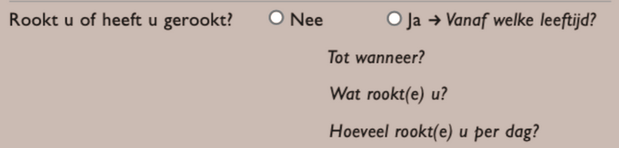
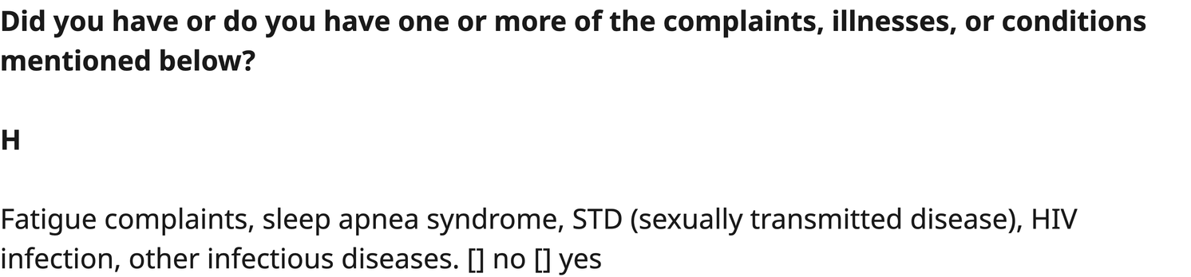
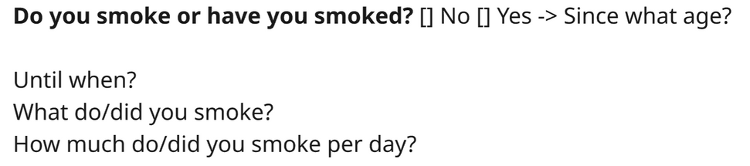
WHAT GOES WRONG
We bundle multiple medical conditions into one question. This creates a false perception that all conditions are treated equally and can push users to under-report to avoid being linked with the “worst” condition.
Some questions combine several separate questions (e.g. asking about past and present behaviour) into one block with only one response option.
BUNDLED CONDITIONS
BUNDLED QUESTIONS
DUTCH
DUTCH
ENGLISH
ENGLISH

Slide 16
BEHAVIOURAL SCIENCE INSIGHT
Bundled questions increase cognitive load which can overwhelm users.
Bundled questions also lead to selective interpretation, where people downplay their own conditions to avoid being associated with the most serious item in the list.

Slide 17
HOW TO FIX IT
Fewer questions ≠ less effort for the customer. Studies have shown that more questions can mean less mental effort if they are simple and focused.
Consider “smart” bundling:
Group items in intuitive categories (e.g. by theme or severity)
Use matrix layouts or “tick all that apply” formats.
Improve readability by avoiding long-form lists and use bullet points instead.

Slide 18
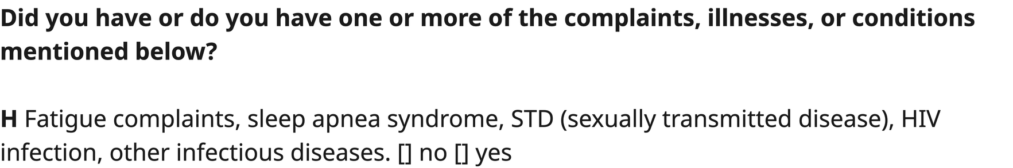
HOW TO FIX IT
BUNDLED CONDITIONS
Which of the following complaints, illnesses or conditions, if any, have you ever experienced? Please tick all that apply:
☐ Fatigue complaints
☐ Sleep apnea syndrome
☐ STD (sexually transmitted disease)
☐ HIV infection
☐ Any other infectious diseases
☐ None of the above

Slide 19
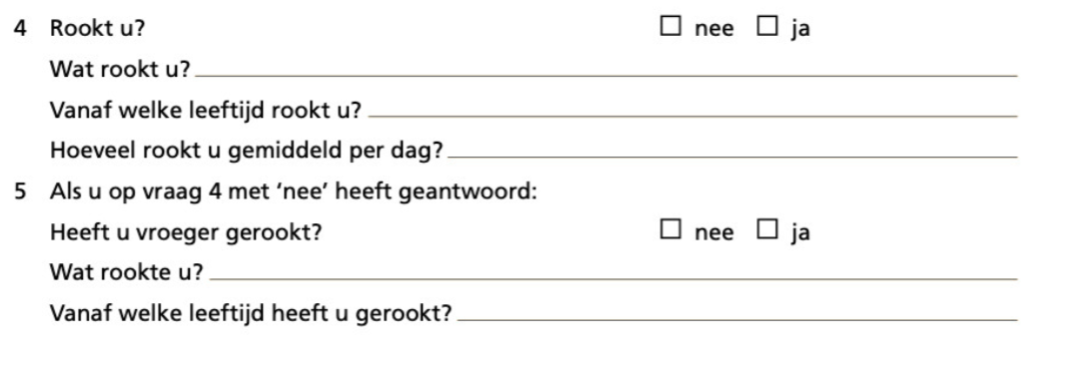
HOW TO FIX IT
BUNDLED QUESTIONS

Slide 20
4
We Don’t Speak the Customer’s Language
Jargon and medical terms make questions harder to answer.

Slide 21
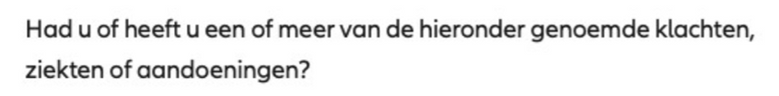
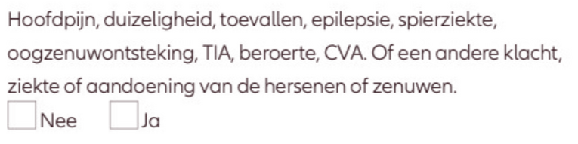
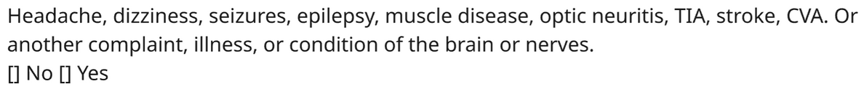
WHAT GOES WRONG
We suffer from the curse of knowledge: taking for granted that people know exactly what medical conditions they have or even what constitutes as a 'medical condition' - and this is revealed in the way we ask questions (e.g. asking about arrhythmia, COPD, diverticulitis etc).
DUTCH
ENGLISH
Notes:
We write questions assuming customers have the same understanding of medical terms and formal diagnoses as an underwriter or a doctor.
Even the term "medical condition" can be ambiguous. Is well-managed high blood pressure a "condition" I need to declare? Users aren't sure.

Slide 22
BEHAVIOURAL SCIENCE INSIGHT
People struggle with “specialist” language and abstract terminology. They recall symptoms, medications, or recent tests far more easily than official medical terms. For example, “I take a pill for my blood pressure" is easier to recall than "I have hypertension".

Slide 23
HOW TO FIX IT
Use concrete, customer-friendly language. Ask questions that they understand and are likely to know the answer to (e.g. "Are you currently taking medication for a heart condition?").
Give definitions where terms may be vague or misunderstood.

Slide 24
HOW TO FIX IT
Did you have or do you have one or more of the complaints, illnesses, or conditions mentioned below?
Headache, dizziness, seizures, muscle disease, inflammation of the nerve to the eye (optic neuritis), mini-strokes (also called transient ischaemic attacks or TIAs), strokes (also called a Cerebrovascular Accident or CVA). Or another complaint, illness or condition of the brain or nerves.
[]No [] Yes
Notes:
Mini-strokes are temporary interruptions of blood flow to the brain that cause stroke-like symptoms but usually last less than 24 hours.

Slide 25
HOW TO FIX IT
EXAMPLE FROM TRAVEL INSURANCE
How many transient ischaemic attacks (if any) have you had in the last 6 months?
☐0
☐ 1
☐ 2 or more
In the last 6 months, how many mini-strokes (also called transient ischaemic attacks or TIAs) have you had, if any? ℹ️
☐ 0
☐ 1
☐ 2 or more
ℹ️ Mini-strokes are temporary interruptions of blood flow to the brain that cause stroke-like symptoms but usually last less than 24 hours.
Notes:
Mini-strokes are temporary interruptions of blood flow to the brain that cause stroke-like symptoms but usually last less than 24 hours.

Slide 26
5
We Ask Subjective Questions that Make it Easier to “Fudge” the Answer
We ask vague or abstract questions, making it easy to bend the truth.

Slide 27
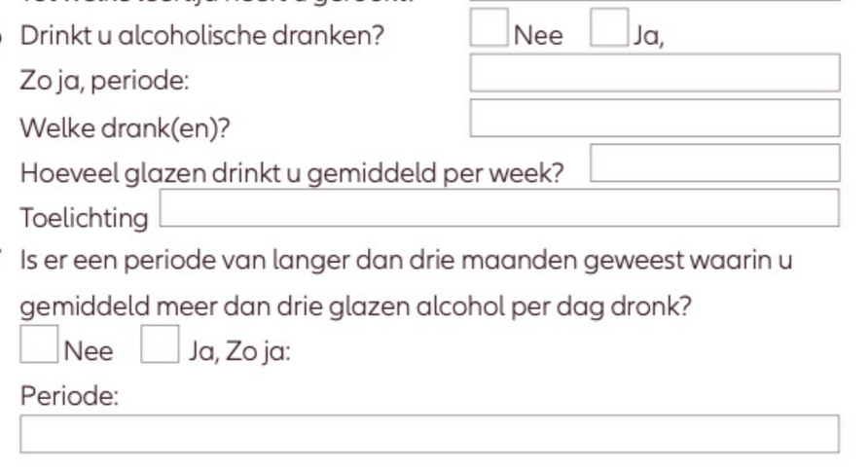
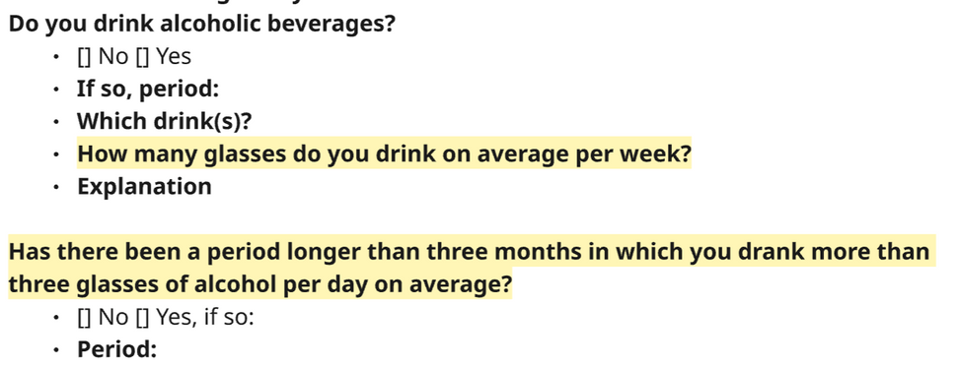
WHAT GOES WRONG
We ask questions that are open to interpretation or require lots of mental effort to answer. This gives the user implicit permission to be imprecise.
We ask for "average" behaviour (e.g., "How much alcohol do you drink on average per week?"). This is subjective and abstract.
We force users to do complex calculations, often in unfamiliar measures, which is a high-effort task.
DUTCH
ENGLISH

Slide 28
BEHAVIOURAL SCIENCE INSIGHT
The ‘Fudge Factor’: Since there's no single, objective "right" answer, it doesn't feel like a lie to bend the truth to seem more acceptable.
The vague framing gives users the wiggle room to answer in a way that fits their desired self-image (e.g., "I'm a moderate drinker"), rather than reflecting their actual behaviour.

Slide 29
HOW TO FIX IT
Replace subjective questions with concrete and verifiable questions.
Ask specific, context-based questions e.g. “Have you visited hospital in the past 5 years for an alcohol-related issue?”. This makes non-disclosure feel riskier because an honest answer is now objective.

Slide 30
6
We Ask Sensitive Questions in Ways That are Insensitive
The way we ask questions about sensitive topics leads to shame around disclosure.

Slide 31
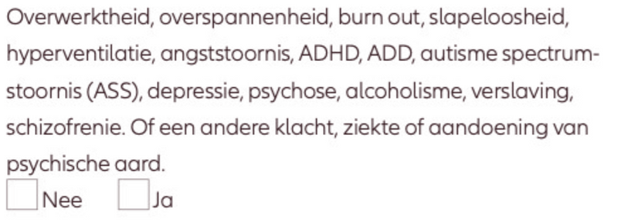
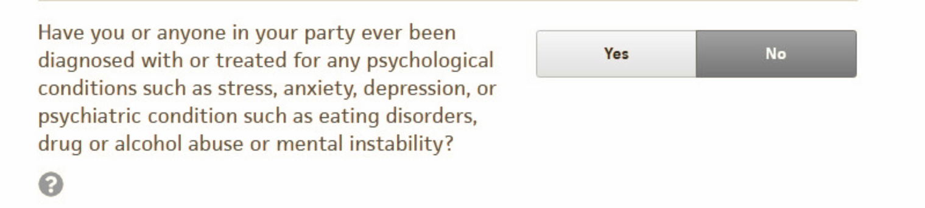
WHAT GOES WRONG
We frame questions around sensitive issues like mental health in ways that imply these conditions are “problems” or “risks”.
This makes people with these conditions feel judged and singled out as if they are outliers for admitting sensitive issues.
DUTCH EXAMPLE
ENGLISH EXAMPLE (TRAVEL INSURANCE)

Slide 32
BEHAVIOURAL SCIENCE INSIGHT
Social Norms: Disclosure increases when people feel their situation is common, not abnormal.
Purpose Builds Trust: People are more willing to share personal information when they understand why it's being asked.

Slide 33
HOW TO FIX IT
Normalise the Question: Use social norm framing to remove the stigma. For example, “Many people experience mental health challenges like anxiety or low mood. If this applies to you, please let us know so we can cover you properly.”
Explain why the information is needed (and how it's in their best interests to disclose). For example, "Being open about your full health history is the best way to ensure this policy provides the long-term financial security you and your family are planning for. It ensures your cover is valid, right from the start."

Slide 34
HOW TO FIX IT
Many people experience mental health challenges like anxiety or depression. It's important that we understand if you experience this to ensure you are fully covered when you need it.
Which of the following have you ever been diagnosed with or treated for? Please select all that apply.
☐ Any psychological conditions (e.g. stress, anxiety, depression)
☐ Any psychiatric conditions (e.g. eating disorders)
☐ Drug or alcohol abuse
☐ None of the above
Notes:
When the lay person thinks about travel insurance, they are expecting cover for things like flight delays or lost baggage. It is not immediately obvious why they need to answer detailed medical questions as part of their insurance journey.

Slide 35
Recap
Six ways we might be making it hard to be honest:
1) We Ask for Honesty Too Late
2) We Signal the “Right” Answer
3) We Bundle Questions to Shorten the Journey but Add Complexity
4) We Don’t Speak the Customer’s Language
5) We Ask Subjective Questions that Make it Easier to “Fudge” the Answer
6) We Ask Sensitive Questions in Ways That are Insensitive
Notes:
BUT WE ALSO
7) Fail to show how honesty is in their best interest
8) Assume customers will read pages & pages of technical text
9) Label People and Use Accusatory Language

Slide 36

HUNGRY FOR MORE?
Behavioural Science brought to life: hands-on workshop tackling a real customer pain-point
When? Today at 2:40pm or 3:45pm
Where? Athene 3 & 4
Thank you!
Any Questions?

